Slide 1



Project Name:
Digital Trainer for Yoga Pose Estimation using Deep Learning
Charotar University of Science and Technology
Devang Patel Institute of Advance Technology and Research
Project Guide: Prof. Parth Goel, Prof. Krishna Patel
Prepared by: Rishi Shah (18DCS110), Dev Kotak (19DCS054) , Jay Desai (19DCS028)
Project ID : SSIP-DPST-2021-05

Slide 2

Contents
Project Description
Objectives with current status
Completed tasks
Tasks for next quarters
Learning Completed

Slide 3
Project Description
This project is to build a self-instruction exercise system that allows people to learn and practice exercises correctly by themselves.
This project lays the foundation for building such a system by applying various machine learning and deep learning approaches to accurately classify yoga poses on pre recorded videos or images.
The project also discusses various pose estimation and keypoint detection methods.

Slide 4
How we stand different?
Current research has been made a significant change to the system but sadly it still lies under the one-way communication system.
We propose the project as real-time two way communication solution to not only estimate the pose detection but to give feedback to correct the pose.
Also the proposed data set is the expansion in terms of limitation with the smaller data set available.

Slide 5
Objectives
Objectives | Status | Expected Completion Time
Data Collection and Preprocessing | completed | 4 months
Neural Network Training and Testing | completed | 3 months
Software development and integration with Neural Net | Completed | 3 months
UI/UX development and Software Testing | Yet to be completed | 2 months
Deployment and real time yoga pose Estimation and Sequencing | Yet to be completed | 3 months

Slide 6
Tasks completed
Task | Outcome
Examine the available dataset | Examined the dataset in detail and collected sample dataset for testing purpose. [link]
Explore different pose detection methodologies | We identified which technique will give best output
Implementation of pose estimation part | Learnt about Mediapipe for keypoint detection
Trained LSTM neural network model for better accuracy | Concluded with asanas and classes for the dataset to be collected.
Refer few completed researches | Reference 1 2. Reference 2

Slide 7
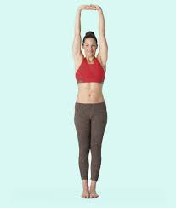
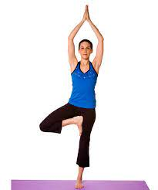
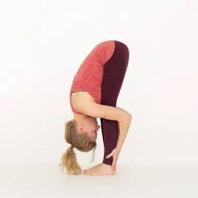
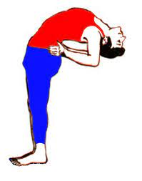
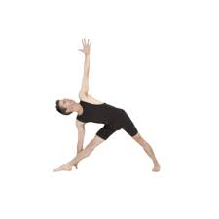
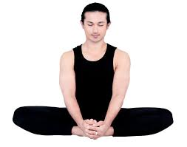
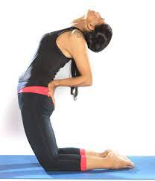
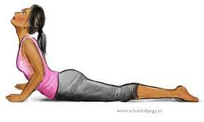
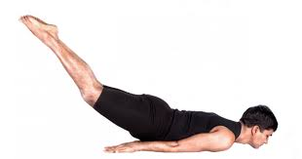
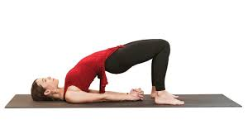
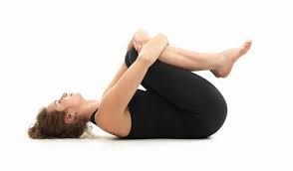
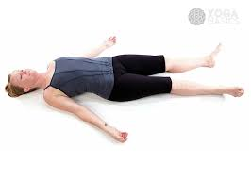
Proposed Classes and Category for Dataset
In total of 9 asanas were proposed as the classes which are mentioned below:
Vrajarasana
Padmasana
Akarnadhanurasana
Bhujangasana
Trikonsana
Vrikshasana
Utakata konasana
Virbhadrasana
Tadasana

Slide 8
External References
Yoga Instructors
Mr. Chandrakant Thakor - Certified National Yoga Trainer
Mr. Kartik Thakor - Certified National Yoga Trainer
Research Scholar
Mr. Santoshkumar Yadav - Researcher BITS Pilani (Yoga Detection and data set publishing) [link]
- Co-Founder and CTO at DeepBlink

Slide 9
Tasks completed
Task | Outcome
Implemented key point detection with mediapipe | It accurately detects the keypoints of poses.
Angle between keypoints calculated. | Angle heuristic approach for lite solution.
Classification using angle heuristic method | Classification is performed on sitting and standing asanas.
Visualize the output | Outputs the graphical representation of predicted poses.

Slide 10
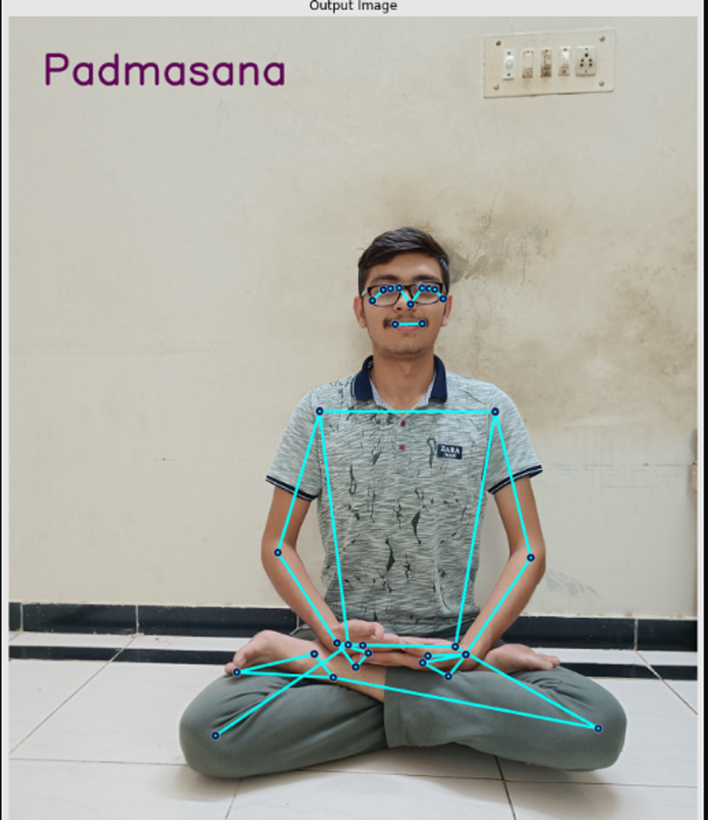
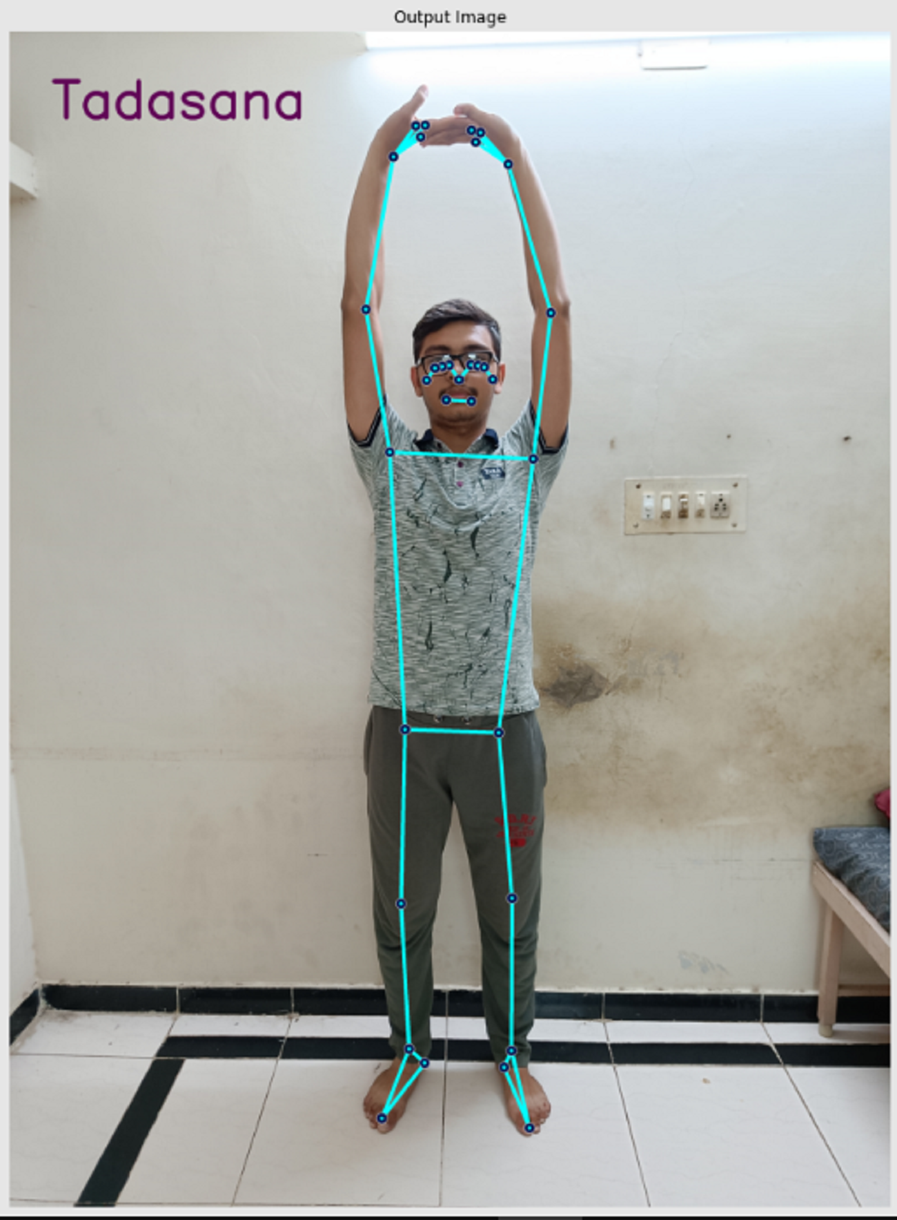
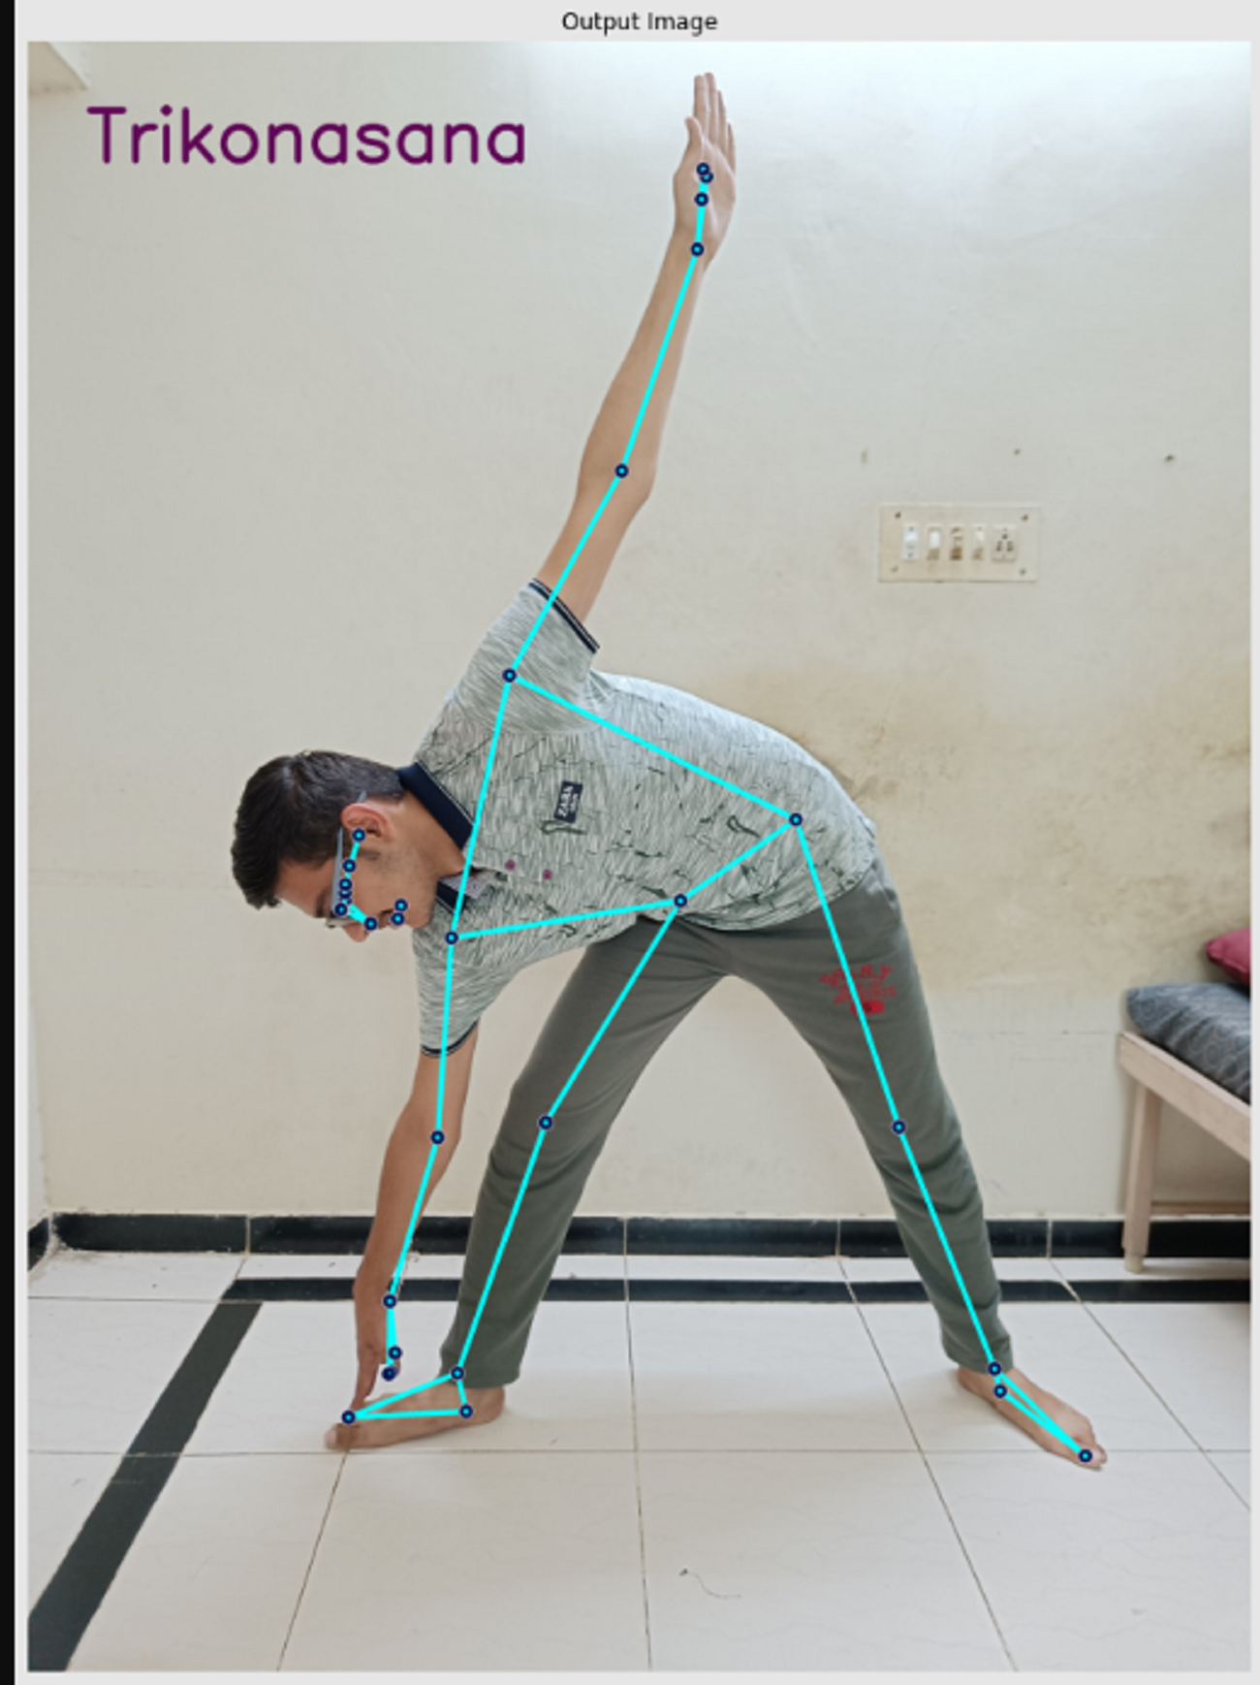
Snapshots

Slide 11
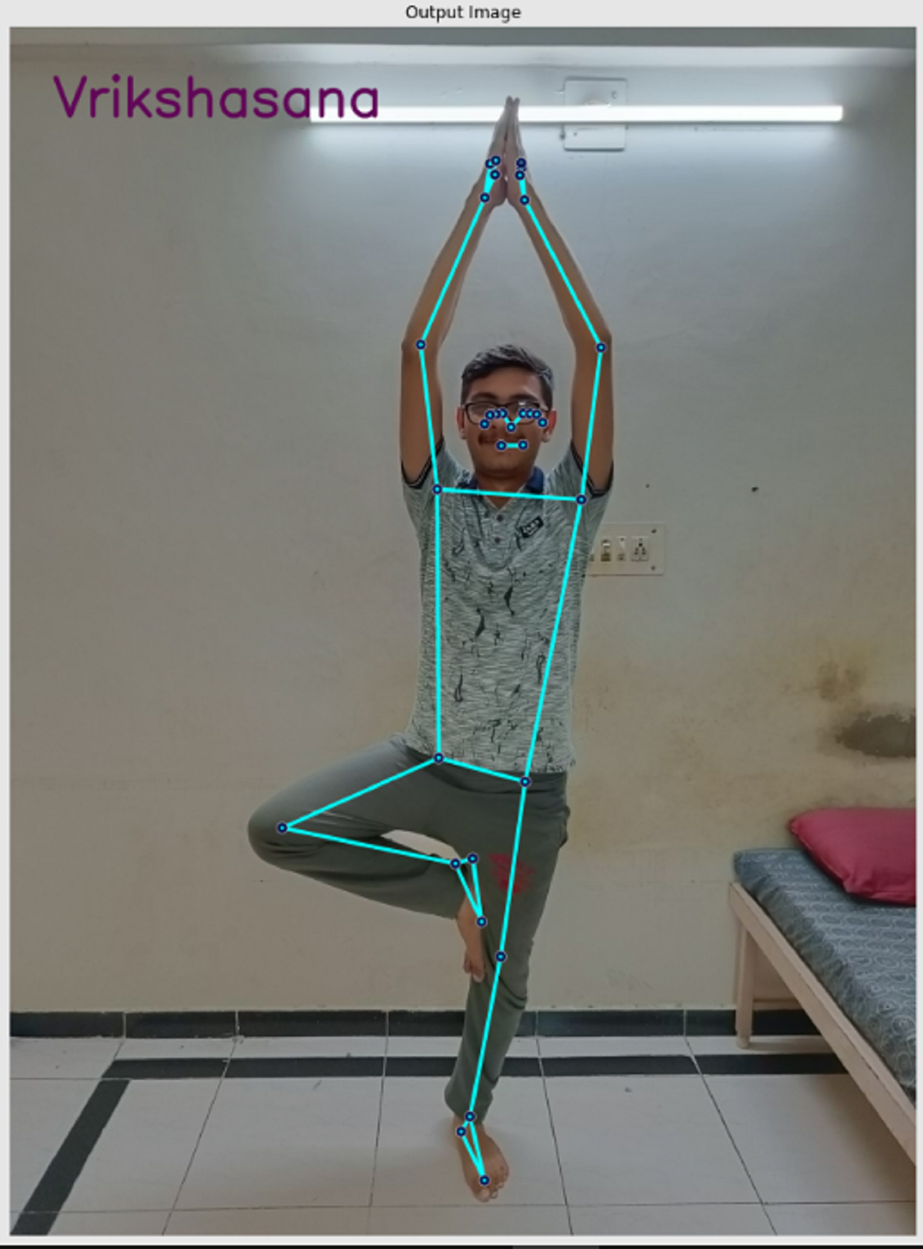
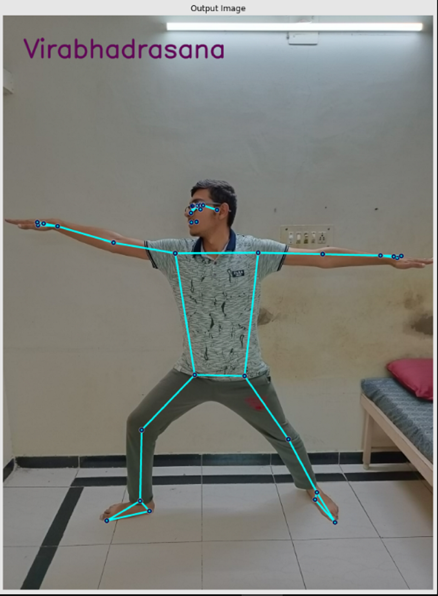
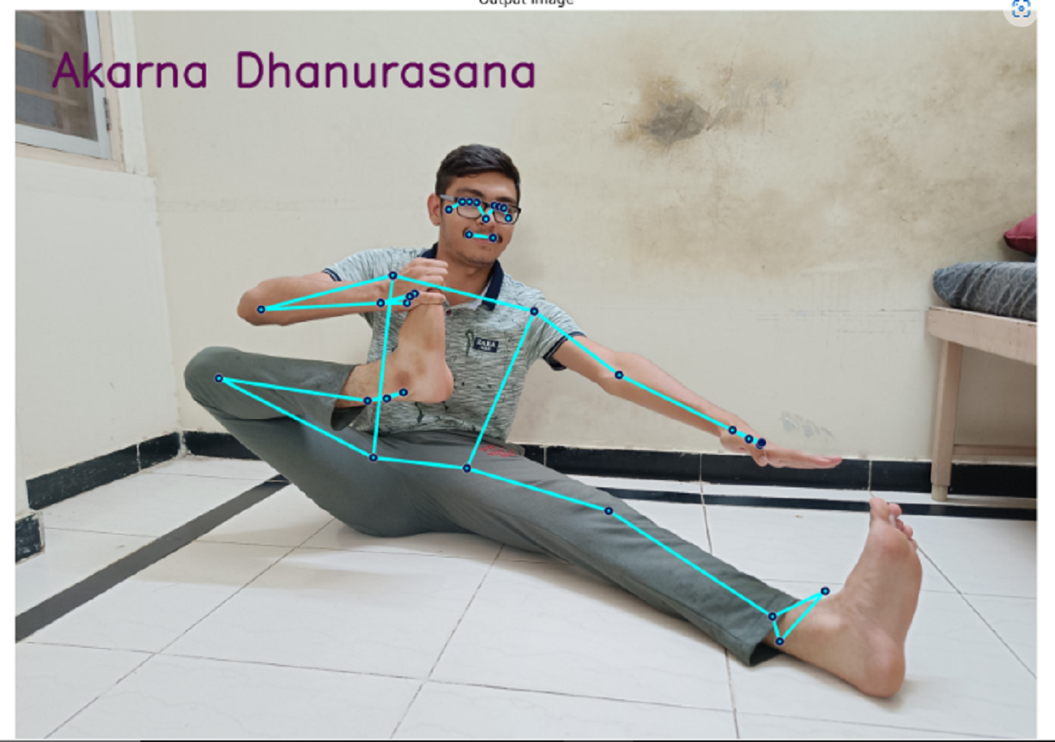
Snapshot continue....

Slide 12
Research paper publication
4th International Conference on Inventive Research in Computing Applications ICIRCA 2022
Paper title- Yoga Pose Classification using Angle Heuristic Approach
In this paper angle heuristic approach is followed which classifies the yoga asanas based on the angles of keypoints.
It helps to develop lite solution for low configuration devices.
Limitations of this approach can be overcome by proposed solution using deep learning solutions.

Slide 13
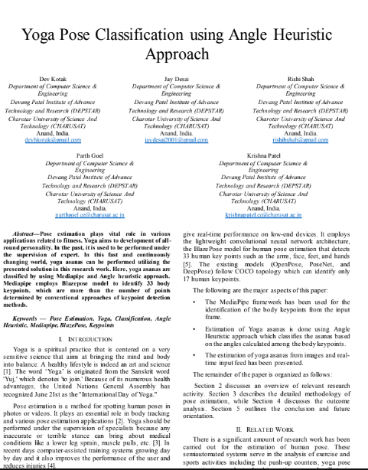
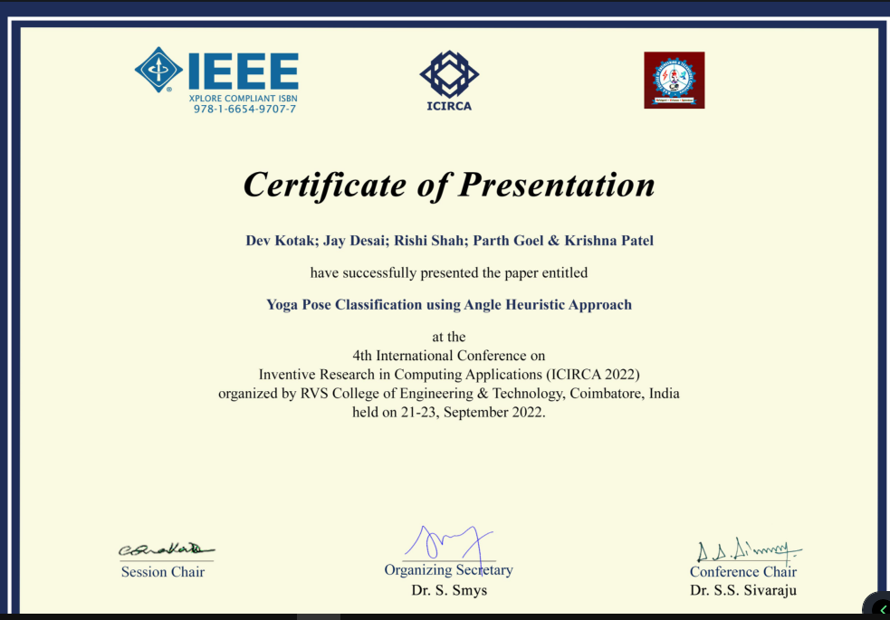
Snapshot of conference presentation

Slide 14
Tasks planned for Next Quarters
Different techniques of deep learning to optimize the solution.
Verification system for asanas which are made by users.
Integration of proposed solution to software.

Slide 15
Q? & A
Thank you

